Slide 1
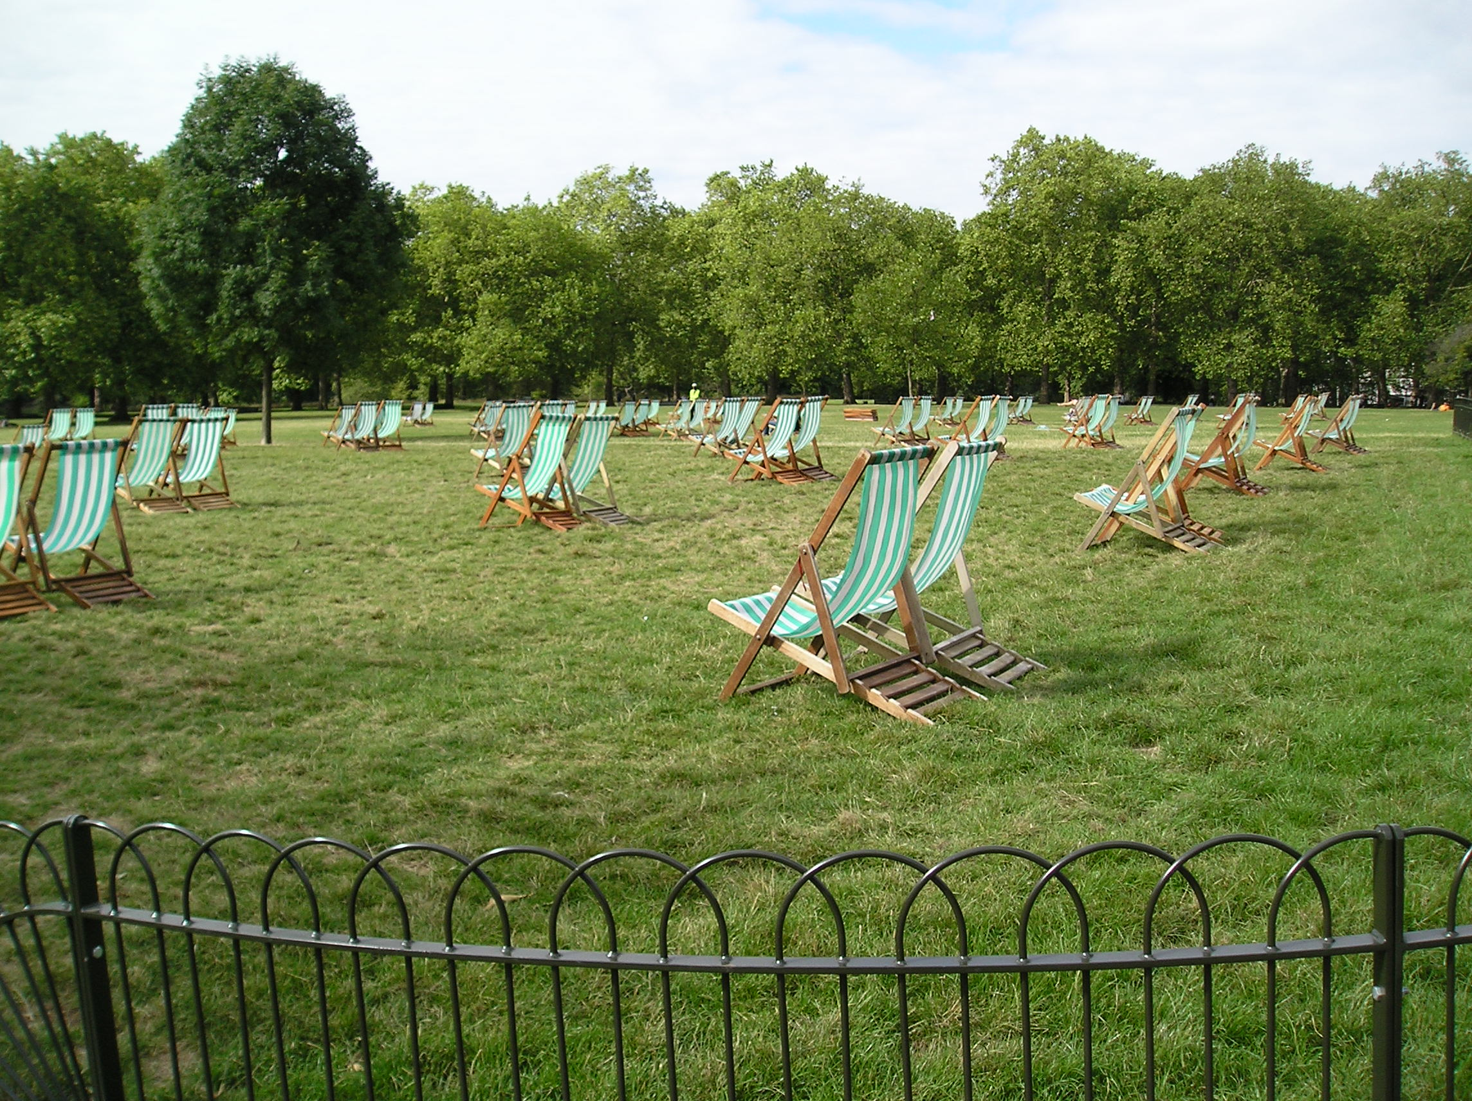

Slide 2
Summer reading

Slide 3
1. Every book will teach
you something

Slide 4
2. Books give you access to experiences & emotions
you have never had

Slide 5
3. Reading makes you smarter

Slide 6
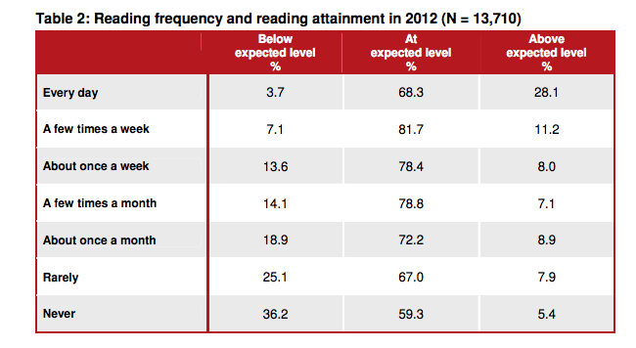

Slide 7


Slide 8
The ‘summer dip’

Slide 9
The ‘Summer dip’ happens over the school holidays, if students don’t read.

Slide 10
4
Research shows that as few as four books read over the summer break can help students to avoid the dip.

Slide 11
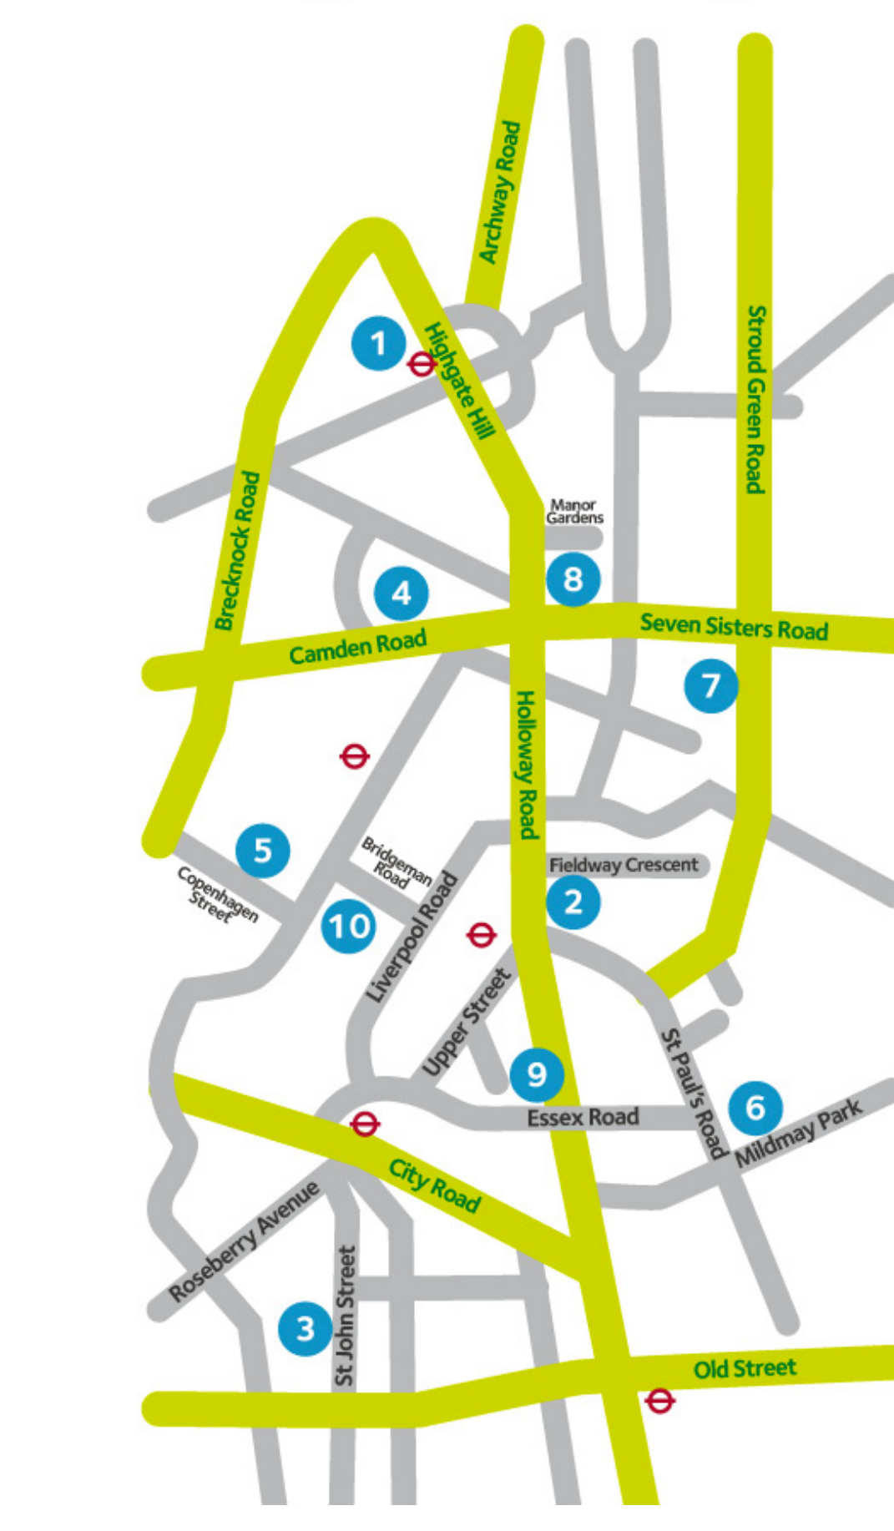
Archway Library
Central Library
Finsbury Library
Islington Local
History Centre
Islington Museum
Home Library Service
John Barnes Library
Lewis Carroll
Children’s Library
Mildmay Library
N4 Library
North Library
South Library
West Library

Slide 12
Archway Library
Central Library
Finsbury Library
Islington Local
History Centre
Islington Museum
Home Library Service
John Barnes Library
Lewis Carroll
Children’s Library
Mildmay Library
N4 Library
North Library
South Library
West Library
Library opening times:
www.goo.gl/a6tYQD

Slide 13

The Oxfam book shop on Islington Green sells second hand copies of books for about £2.50 each.

Slide 14

On Amazon, you can buy second hand books for as little as a penny. If you include postage, a book can come to just £2.81

Slide 15

Summer writing

Slide 16
Writing a journal
Write postcards to friends and family if you go on holiday
Write a letter to a friend – it’s always nice to have something written down
Write thank you letters to people who do lovely things for you and hand-deliver them

Slide 17
Write a story – set your imagination free!
Write a news article about something happening in your area (and start your career as a journalist by submitting it to a local newspaper)
Write a letter to the editor of a newspaper when you see a story you are unhappy about

Slide 18

My summer reading

Slide 19






Slide 20







Slide 21


Slide 22


Slide 23


Slide 24


Slide 25
7
Year 7 suggestions

Slide 26






Slide 27







Slide 28


Slide 29


Slide 30


Slide 31


