Slide 1
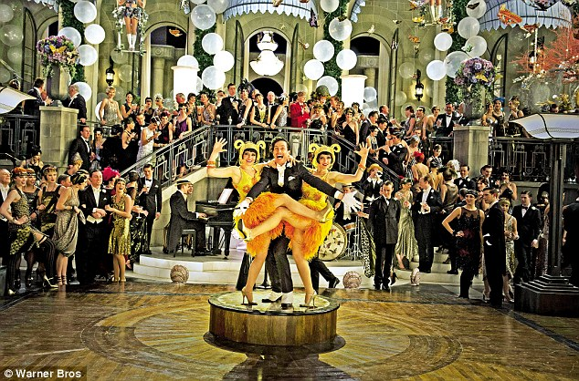
What ideas does this image give you?

Slide 3
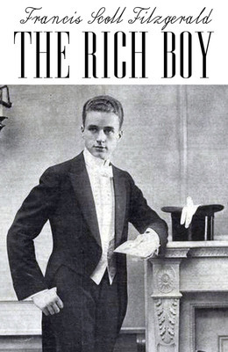
What can you guess about the story we will be reading from its front cover?

Slide 5
Today we are practising inference and learning new vocabulary.

Slide 6
Begin with an individual, and before you know it you find that you have created a type; begin with a type, and you find that you have created—nothing.
What does Fitzgerald mean?
Why begin like this?

Slide 7
There are many ambitious words in this story.
As one of our class aims is to expand our vocabulary, make sure you note down new words you’d like to learn as we read.

Slide 8
Let me tell you about the very rich. They are different from you and me. They possess and enjoy early, and it does something to them, makes them soft where we are hard, and cynical where we are trustful, in a way that, unless you were born rich, it is very difficult to understand. They think, deep in their hearts, that they are better than we are because we had to discover the compensations and refuges of life for ourselves. Even when they enter deep into our world or sink below us, they still think that they are better than we are. They are different. The only way I can describe young Anson Hunter is to approach him as if he were a foreigner and cling stubbornly to my point of view. If I accept his for a moment I am lost--I have nothing to show but a preposterous movie.

Slide 9
Queer
Proclaiming
Abnormality
Conceal
Protestation
Misprison

Slide 10
Why use the first person?

Slide 11
Compensations
Refuge
Preposterous
Superiority
Deference
Disdained

Slide 12
What do you know about the family?
What do you infer?

Slide 13
Feudal
Clan
Aspirations
Conventional
Irreproachable
Idealism
Illusion
Compromise
Avid

Slide 14
What is your impression of life for the very rich?
What details does Fitzgerald include to make us visualise it?

Slide 15
Emasculated
Hypnosis
Facetiousness
Cynicism
Engrossed
Constraint
Rapt
Intensity

Slide 16
How does Fitzgerald use language in an interesting way to show them falling in love?

Slide 17
Communion
Authoritative
Naïve

Slide 18
Independent writing:
How does Fitzgerald set the scene in “The Rich Boy”?
You may wish to consider:
  What ideas does he introduce?
  What methods does he use?
  What are the characters or setting like?

Slide 19
Finally:
What is your favourite new word you have learned today?
Use it in an original sentence (one you have made up yourself).

Slide 20
To begin:
2.2.15
Match the image with the name of the place.

Slide 21
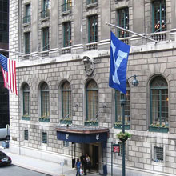
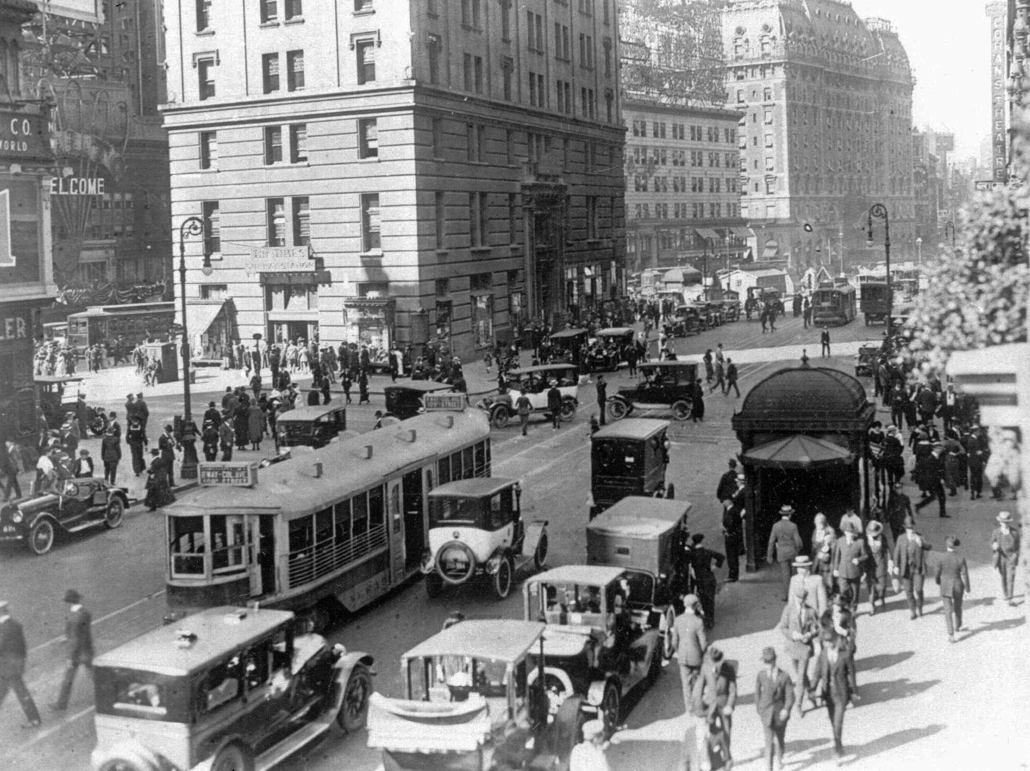
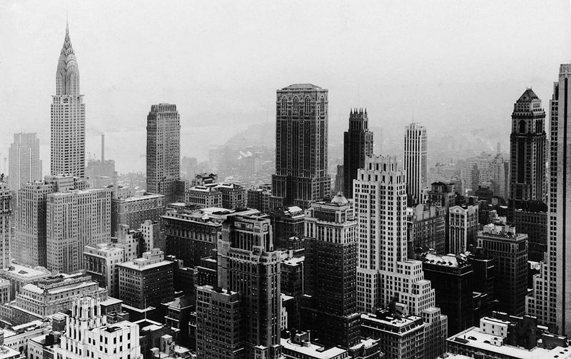
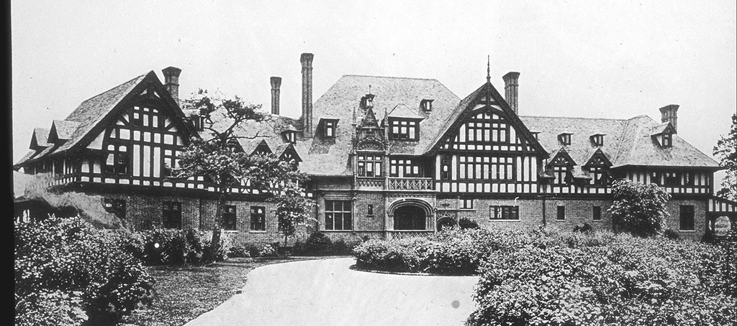
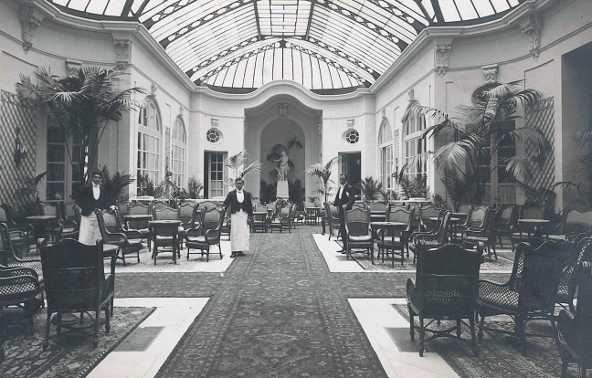
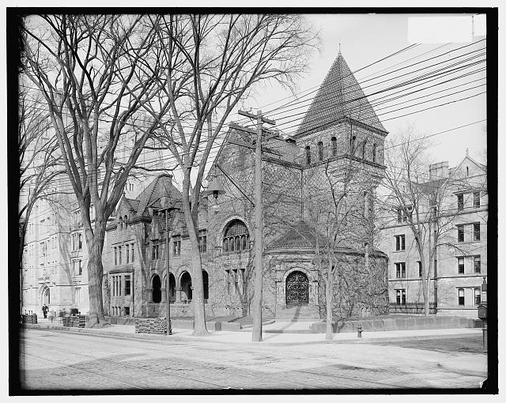
Yale
New York
Ritz
Yale club
Madison avenue
Long Island

Slide 22
What kind of
world do these
characters live
in?

Slide 23
Today we are learning and using new vocabulary and practising using language devices.

Slide 24
Sobered
Boisterously
Quaint

Slide 25
Indifferent
Incident
Humility
Dominated
Solidity
Self-indulgence
Alternating
Paternal

Slide 26
What kind of relationship is this?

Slide 27
Vitality
Reckless
Armistice
Temperaments
Flagrantly

Slide 28
What hints does Fitzgerald give us about their relationship?

Slide 29
Acute
Vigorously
Post-bellum
Brokerage
Opulent
Abundance
Occurrences
Precarious
Paunches

Slide 30
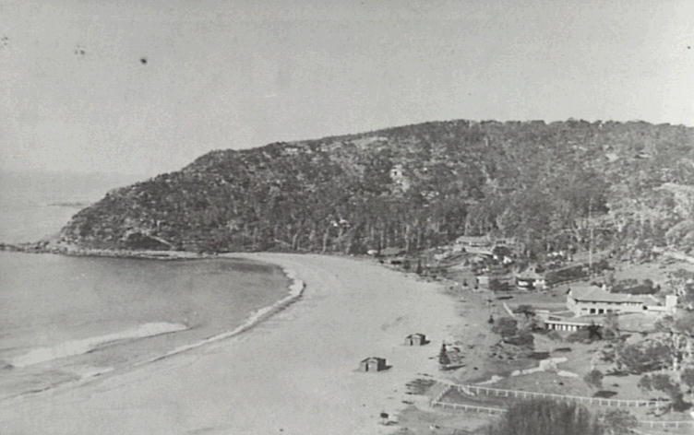
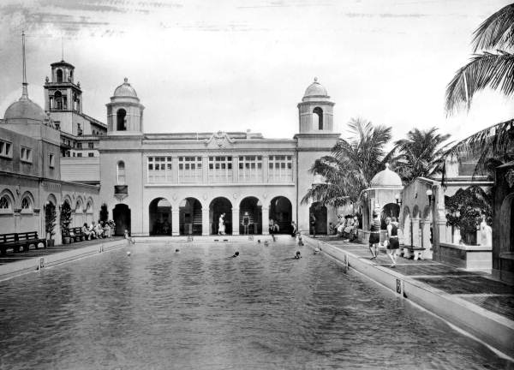
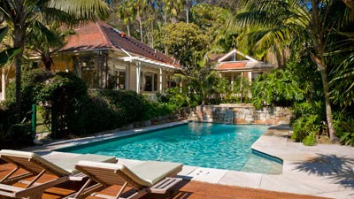
Palm Beach

Slide 31
Palm Beach
Palm Beach sprawled plump and opulent between the sparkling sapphire of Lake Worth, flawed here and there by house-boats at anchor, and the great turquoise bar of the Atlantic Ocean. The huge bulks of the Breakers and the Royal Poinciana rose as twin paunches from the bright level of the sand, and around them clustered the Dancing Glade, Bradley's House of Chance, and a dozen modistes and milliners with goods at triple prices from New York. Upon the trellissed veranda of the Breakers two hundred women stepped right, stepped left, wheeled, and slid in that then celebrated calisthenic known as the double-shuffle, while in half-time to the music two thousand bracelets clicked up and down on two hundred arms.
What can you say about this description?

Slide 32
Veranda
Callisthenic
Abstractedly
Humbly

Slide 33
How is this character’s speech made believable?

Slide 34
Wrung
Enigma
Restless
Intimated
Stout
Conservative

Slide 35
Instinctive
Episcopal
Administered
Declined

Slide 36
How is Anson treated by his friends?
How does he view them?
Would you want to be him?

Slide 37
Indiscriminately
Cynic
Profound
Notorious
Slackly
Indiscreetly
Unconventionality
Obsolete

Slide 38
How does Fitzgerald create a vivid image of Dolly?
What are the key telling details?

Slide 39
Sybarite
Debutante
Infatuation
Engulfed
Liberty
Certitudes
Feverish
Weary

Slide 40
Tragic
Monologue
Reproaches
Intimacies
Contemptuously
Epistles
Decoy
Vitality
Timorous

Slide 41
“Me” – who is the narrator?

Slide 42
Compelling
Scarcely
Ascended
Notion
Opaque

Slide 43
Embraced
Artificial
Twilight
Uncalculated

Slide 44
Why do you think there is a lack of description of place?

Slide 45
Language devices:
Sparkling sapphire
The smoke banked like fog
Her emotions yielded to him
The words wrung her heart like hands

Slide 47
Independent writing:
Choose any of the locations in “The Rich Boy.”
Describe it, using language techniques and some of the vocabulary you have learned today.

Slide 48
Homework:
Look up the words on the sheet and write their definitions.
Due Wednesday.

Slide 49
To begin:
What words would you use to describe the world of “The Rich Boy”?
Think about:
  The physical world
  The emotional world
  The spiritual world
Challenge yourself to use marvellous words!

Slide 50
What words would you use to describe the world of “The Rich Boy”?
  The physical world
  The emotional world
  The spiritual world

Slide 51
Today we will learn new vocabulary and write splendid descriptions.

Slide 52
Remember:
Note amazing vocabulary as we read
Ask questions
Make comments about ideas in the text

Slide 53
Ascertained
Thrice
Abomination
Solicitously
Interfered

Slide 54
What makes the last paragraph of this chapter effective?
For a long time afterward Anson believed that a protective God sometimes interfered in human affairs. But Dolly Karger, lying awake and staring at the ceiling, never again believed in anything at all.

Slide 55
Foretaste
Checked
Circumspect
Vicarious

Slide 56
Has our view of Anson changed?
If so, how?

Slide 57
Reproach
Congenial
Rarity
Intrigue
Dissolute
Disquieting
Reversion
Solidarity
Intuition

Slide 58
Hostility
Peremptory
Chivalry
Frantic
Luncheon
Scandal
Significant
Absurd

Slide 59
Disquisition
Dalliance
Fundamentalist
Vagary
Obdurate
Resumption

Slide 60
Permanence
Resourcefulness
Will
Feebly

Slide 61
Outside it was dark, save for a blurred glow from Sixth Avenue down the street. In that light those two who had been lovers looked for the last time into each other's tragic faces, realizing that between them there was not enough youth and strength to avert their eternal parting. Sloane walked suddenly off down the street and Anson tapped a dozing taxi-driver on the arm.
It was almost four; there was a patient flow of cleaning water along the ghostly pavement of Fifth Avenue, and the shadows of two night women flitted over the dark façade of St. Thomas's church. Then the desolate shrubbery of Central Park where Anson had often played as a child, and the mounting numbers, significant as names, of the marching streets. This was his city, he thought, where his name had flourished through five generations.
Notes:
p. 21

Slide 62
Conventional
Diminished
Yielded
Obsequies
Hollow

Slide 63
How does Fitzgerald show a change?

Slide 64
Scarcely
Officiated
Despair
Inroads
Commuters
Keenly
Exorcised
Advisability
Intimate
Homeric

Slide 65
Indiscretions
Unpopulated
Accumulation
Momentarily
Vacant
Resignation

Slide 66
How do others view Anson?
How do you know?

Slide 67
How do others view Anson?
How do you know?
How does Fitzgerald show not tell this?

Slide 68
Jolt
Rural
Diminutive
Gaiety
Dissimulation
Specimen

Slide 69
Immured
Quest
Roved
Intolerable

Slide 70
What is Fitzgerald’s point?
Why is he telling this story?

Slide 71
Indicated
Gesture

Slide 72
Why does Paula re-enter the story?
What will happen?

Slide 73
What makes an amazing description?

Slide 74
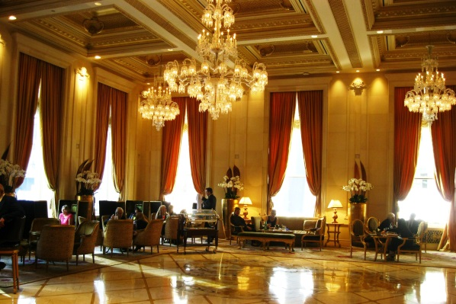
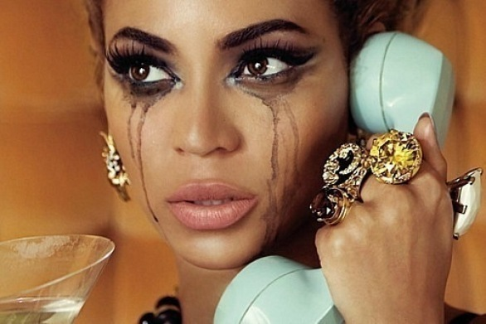
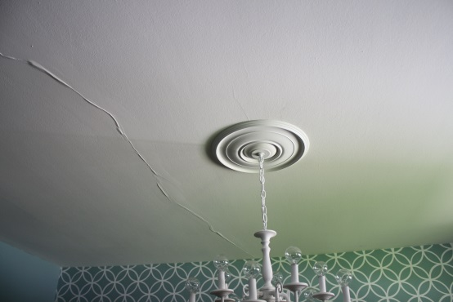
Independent writing:
Describe any of these in sumptuous detail, taking care to use at least five of the new words you have learned today.

Slide 75
Finally:
What, in your view, are the rules of writing effective descriptions?

Slide 76
To begin:
Do you like the character of Anson?
Why/why not?

Slide 77
To begin:
Do you like the story “The Rich Boy”?
Why/why not?

Slide 78
Today we will explore the writer’s methods.

Slide 79
Writer’s methods:

Slide 80
Caress
Esoteric
Abstractedly
Homage
Languor
Infatuated

Slide 81
What does happiness mean?
What makes Anson happy?

Slide 82
Resisted
Invariably
Transaction
Preoccupation
Sufficient
Joviality
Exhibit

Slide 83
How is Paula’s death shown?
Why is it effective?

Slide 84
Joyous
Anticipation
Gusto
Cherished

Slide 85
Look at the last paragraph.
What is the impression Fitzgerald wants us to go away with?

Slide 86
I saw less of him on the trip than I had hoped. He wanted to arrange a foursome, but there was no one available, so I saw him only at meals. Sometimes, though, he would have a cocktail in the bar, and he told me about the girl in the red tam, and his adventures with her, making them all bizarre and amusing, as he had a way of doing, and I was glad that he was himself again, or at least the self that I knew, and with which I felt at home. I don't think he was ever happy unless some one was in love with him, responding to him like filings to a magnet, helping him to explain himself, promising him something. What it was I do not know. Perhaps they promised that there would always be women in the world who would spend their brightest, freshest, rarest hours to nurse and protect that superiority he cherished in his heart.

Slide 87
What methods does F. Scott Fitzgerald use to make his story an effective one?

Slide 88
Independent writing:
What kind of character is Anson and what methods does Fitzgerald use to show his readers this?

Slide 89
Finally:
What do you think about this story?
What have you gained from reading it?

