Slide 1
Starter:
23.2.15
Are men and women equal in our society?
Explain why/why not.

Slide 2
23.2.15
Are men and women equal in our society?

Slide 3
Starter:
23.2.15
Read through the paragraph.
Do any of the facts surprise you?

Slide 4
Surprising facts:
23.2.15

Slide 5
Today we will use facts to persuade an audience.

Slide 6
Politics means…
Parliament means…
Representation means…

Slide 7
We will now read through the information about women in politics.
Highlight or underline any facts which interest you.

Slide 8
What language techniques persuade an audience?

Slide 9
Read through the further information about women in politics.

Slide 10
What language techniques persuade an audience?

Slide 11
Independent writing:
Write a speech, persuading your audience that women need to be more involved in politics.

Slide 12
Finally:
Read carefully through your speech.
Highlight or underline the most persuasive sentences. Annotate in the margin: what makes this persuasive?

Slide 13
Finally finally:
Look at the statistics on women’s pay.
If you were a politician, how would you make this better?

Slide 14
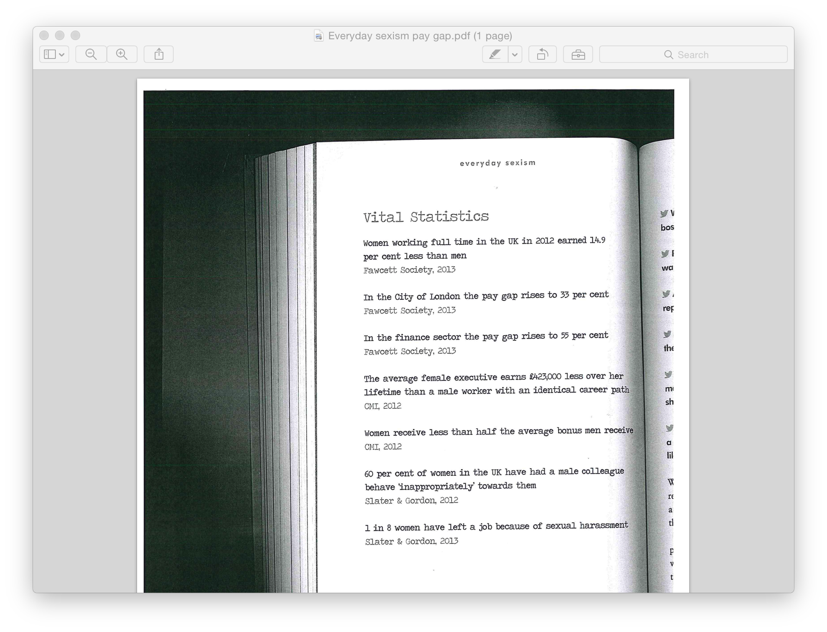

Slide 15
Starter:
23.2.15
Who is your favourite female lead character in a film?
What does she do in the film?
What is she interested in?
How does she look?

Slide 16
Favourite female leads:

Slide 17
Who is your least favourite female character in a film?
Why?
What does she do in the film?
What is she interested in?
How does she look?

Slide 18
Today we are practising our persuasive techniques and exploring how women are presented in the media.

Slide 19
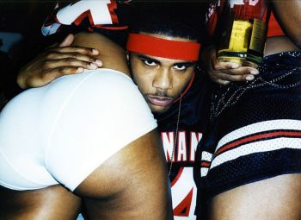
How are women perceived here?

Slide 20

How are women perceived here?

Slide 21
Persuasive techniques:

Slide 22
As we read through the information about the media’s effect on girls, highlight or underline:
  Key information about how women are presented in films
  Any persuasive techniques the author uses

Slide 23
How does the representation of women in the media affect girls?

Slide 24
We will now read more information about the representation of women in the media.
Highlight or underline:
  Key information about how women are presented in films
  Any persuasive techniques the author uses

Slide 25
Can you think of any more examples of women being presented in unacceptable ways in the media?

Slide 26
Women in the media:

Slide 27
In an ideal world, how should women be presented in the media?

Slide 28
What changes could film/record executives make to ensure women are better represented?

Slide 29
Independent writing:
Write a letter to the CEO (Chief Executive Officer) of Warner Brothers, Kevin Tsujihara, about the way women are presented in films or to the Chairman of Sony BMG (music label) David Gordon.
What are you angry about? What can Mr Tsujihara/Mr Gordon do about it?

Slide 30
Finally:
What would the ideal female heroine of a film be like?
How would she look?
What would she be interested in?
What would she do?

Slide 31
To begin:
Write a definition for each of these silently in your books:
Nouns:
Verbs:
Adjectives:
Pronouns:

Slide 32
Starter:
25.2.15
What do you enjoy reading and why?

Slide 33
Starter:
25.2.15
What does “entertainment” mean?

Slide 34
Today we are exploring what makes writing entertaining.

Slide 35
How could an author write to entertain a reader?

Slide 36


Slide 37
Read Lena Dunham’s outline of her day working at a high-end boutique.
What elements make this piece enjoyable to read?

Slide 38
What elements make this piece enjoyable to read?

Slide 39
Write your own “Day in the Life of…”

Slide 40
Anecdote means…
E.g. I told an anecdote from my childhood to entertain year 10.

Slide 41
Read through Dunham’s anecdote about her school trip.
What makes this piece of writing entertaining?

Slide 42
What makes this piece of writing entertaining?

Slide 43
What anecdotes could you tell about your childhood?

Slide 44
What are the key features of entertaining writing?

Slide 45
Independent writing:
Write an entertaining anecdote about something which has happened to you.
Remember to use every opportunity to entertain your reader by…

Slide 46
Finally:
Swap with your partner.
What is entertaining about their piece?
How could they improve it?

Slide 47
Starter:
27.2.15
What do you already know about women in politics?
Can you think of any strong political women?

Slide 48
Women in politics
Strong political women

Slide 49
Today we will understand key facts about Malala Yousafzai.

Slide 50
https://www.youtube.com/watch?v=CXvs1vwiD0M
Watch and take notes on what you learn.

Slide 51
Malala:
Read through the profile of Malala.
Jot down notes about what you learn about her.

Slide 52
Malala:

Slide 53
We will now read through the Guardian article about Malala’s work, which led to her being awarded the Nobel Peace Prize in 2014.
Note:
  New words you would like to learn
  What Malala has done to deserve the prize

Slide 54
New words:

Slide 55
What has Malala done?

Slide 56
Independent writing:
Write a letter to Malala, congratulating her on her achievements and explaining what you aim to do with your life to make the world a better place.

Slide 57
Quiz: Question 1
Where is Malala from?
Notes:
Pakistan

Slide 58
Quiz: Question 2
Malala is the first ___ to win the Nobel Peace prize.
Notes:
Pakistani; Pashtun; young girl

Slide 59
Quiz: Question 3
When was Malala shot, where and by which organisation?
Notes:
October 2012, in the head, by the Taliban

Slide 60
Quiz: Question 4
How old was Malala when she wrote her anonymous diaries?
Notes:
11

Slide 61
Quiz: Question 5
What is Malala trying to do?
Notes:
Fight for the right for equal education

Slide 62
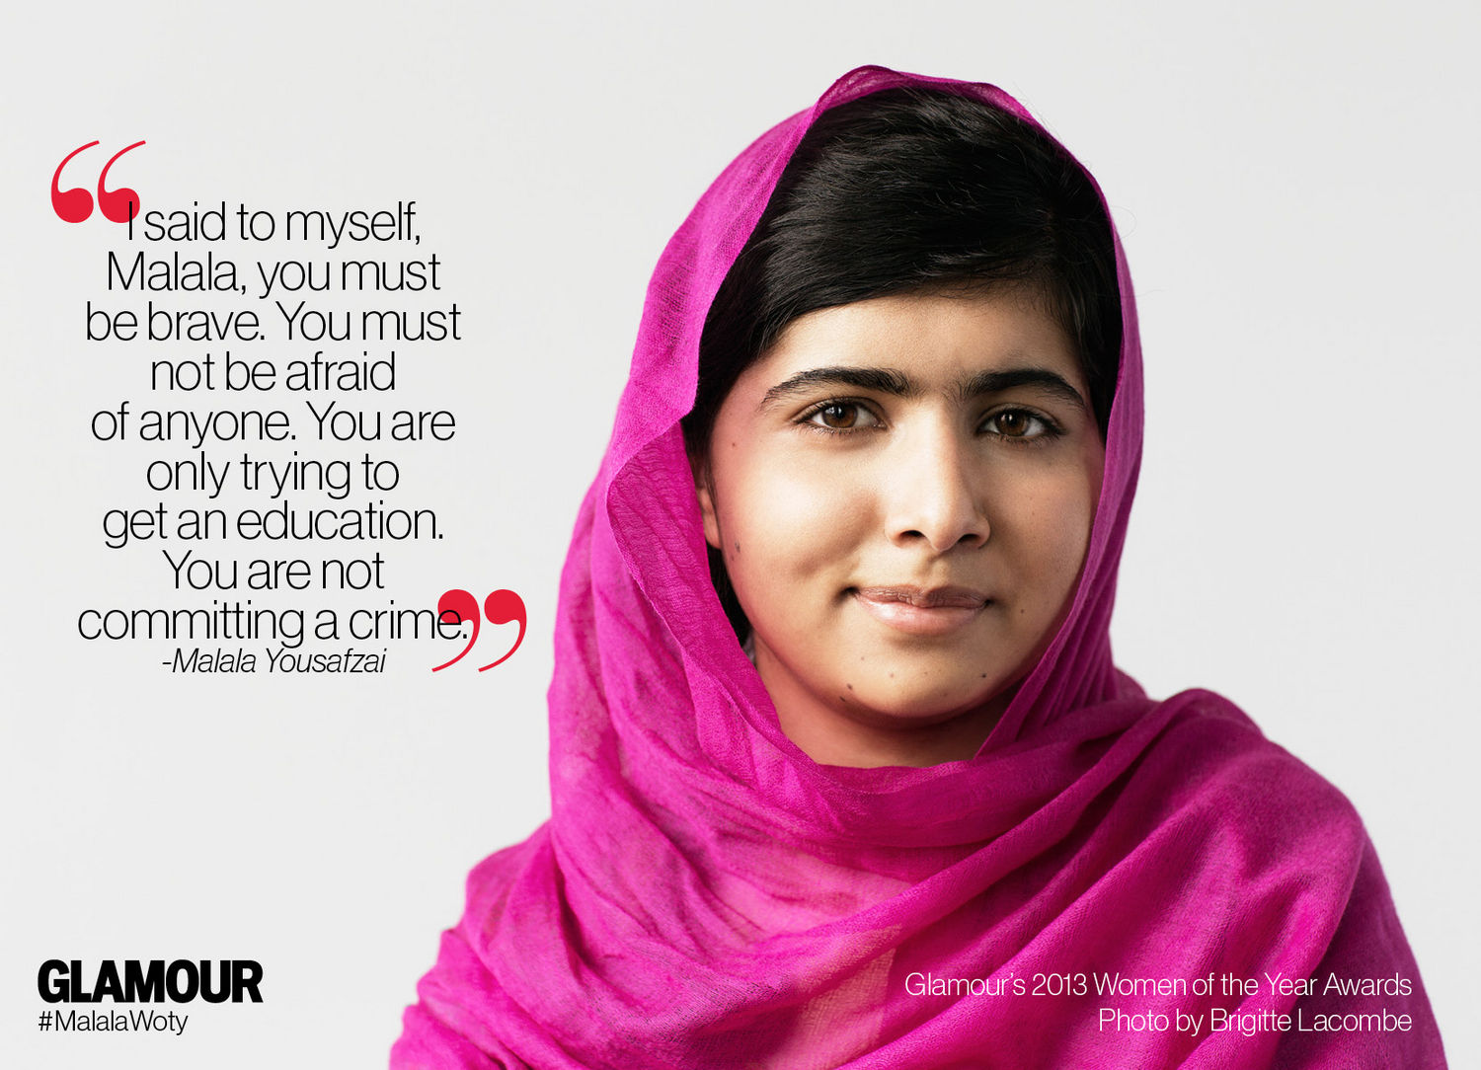
Starter:
What do you remember about Malala?

Slide 63


Slide 64
Today we are exploring ideas about education for women.

Slide 65
Mufti: Muslim legal expert who is empowered to give rulings on religious matters
Maulana: Muslim man revered for his religious learning or piety

Slide 66
As we read, note any new words you learn in your exercise book.

Slide 67
How are women seen by some people in Pakistan?
What is education for women like in Pakistan?

Slide 68
Independent writing:
Write a letter to Malala asking about education for women in Pakistan, and telling her about education in the UK.

Slide 69
Today’s DfE study shows:
Achieving 5 A* to C GCSE grades, including the vital English and maths subjects, adds £80,000 to a student’s earnings over their lifetime.
A further £60,000 is added to their wages if they go on to achieve at least 2 A levels

Slide 70
To begin:
2.3.15
In the UK today, are women equal to men?

Slide 71
To begin:
2.3.15
What are women’s lives like in the UK today?
What is positive?
What is problematic?

Slide 72
Today we will know how to write an informed speech.

Slide 73
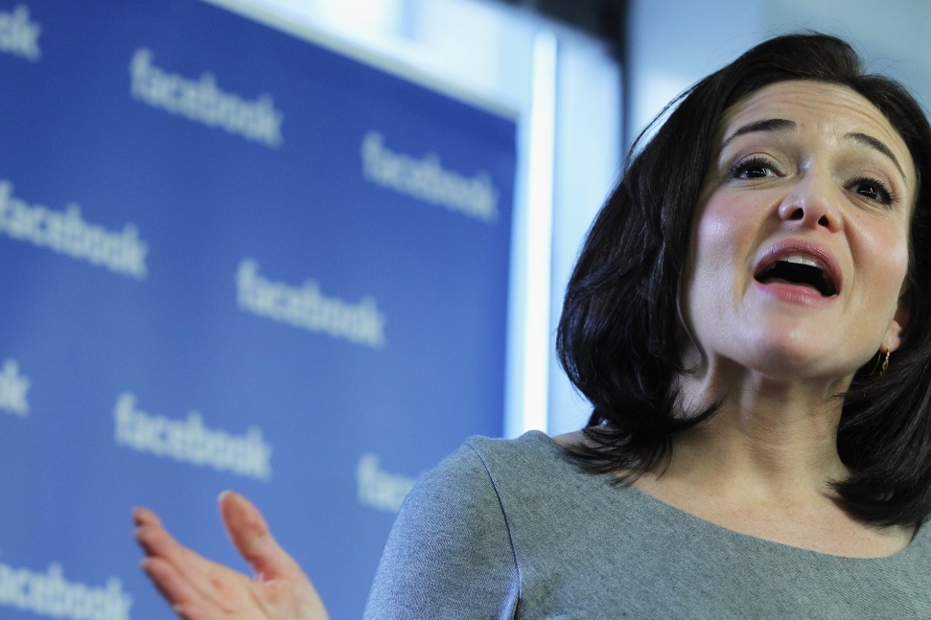
Sheryl Sandberg
Chief operating officer
of Facebook
Previously Vice President of Sales at Google
Born in Washington DC
Previously a consultant at McKinsey & Co
Worth around $1billion due to stock holdings

Slide 74
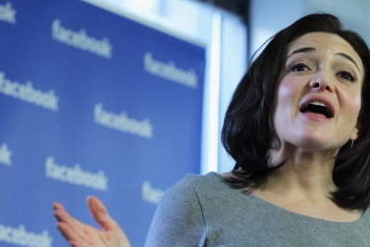
TED
In 2010, Sandberg gave a TED (technology, entertainment, design) talk in which she explained why so few women were in positions of leadership.
As you watch, take notes on any ideas you find interesting/

Slide 75
https://www.youtube.com/watch?v=18uDutylDa4

Slide 76
TED talk notes:

Slide 77
“Lean In”
Sandberg expanded on her ideas in a book called “Lean In.”
As we read the excerpt, take notes on what you learn and any new words.

Slide 78
What makes a great speech?

Slide 79
Success criteria for our speeches:

Slide 80
Independent writing:
Write a speech to be delivered to young women, advising them of how they can make the most of their potential.

Slide 81
Finally:
Deliver your speech to your partner.

Slide 82
To begin:
4.3.15
How did you get to school today?
Respond using as much detail as you can.

Slide 83
What does “writing to inform” mean?

Slide 84
Can “writing to inform” ever be interesting?
How?

Slide 85
Today we will know how to make informative writing interesting.

Slide 86
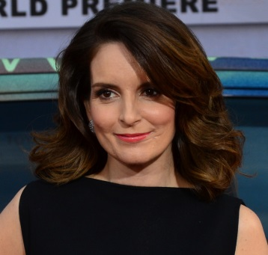
Tina Fey
American actress, comedian, writer and producer.
Best known for her work on the NBC sketch comedy “Saturday Night Live”, and the films “Date Night” and “Mean Girls.”
She has received many awards, including eight Emmy Awards and two Golden Globe Awards

Slide 87
Watch the first minute of the clip.
What do you think of this as an introduction?
https://www.youtube.com/watch?v=M8Mkufm3ncc

Slide 88
Now, watch the next two minutes.
What does this show you about how women are presented in the media?
https://www.youtube.com/watch?v=M8Mkufm3ncc

Slide 89
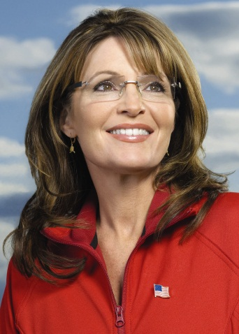
2008 American Elections
Sarah Palin
2008 Vice Presidential candidate for the Republican party
Governor of Alaska
Made fun of in the media for being “stupid”
Her appearance was constantly commented on in a positive way

Slide 90
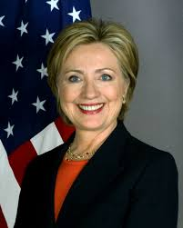
2008 American Elections
Hillary Clinton
Presidential candidate in 2008 but lost out to Barack Obama
Married to former president Bill Clinton
Career woman
Senator for New York
Incredibly intelligent
Appearance commented on in a negative way

Slide 91
https://www.youtube.com/watch?v=vSOLz1YBFG0
What does the clip show you about how women in politics are presented in the media?
(only first 2 minutes – until “pretty, beautiful”)

Slide 92

We will now read through an excerpt from “Bossypants” where Fey informs the reader what a photo shoot is like.

Slide 93
New words:

Slide 94
How does Fey make her writing entertaining for a reader?
Find quotes to support your ideas.

Slide 95
How can we ensure we interest our readers when we write to inform?

Slide 96

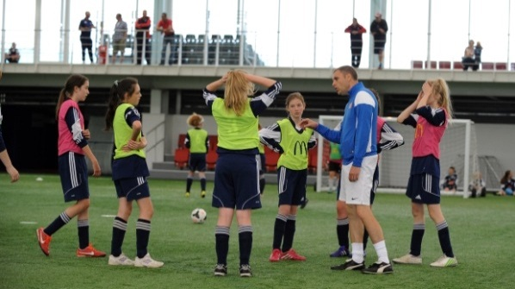
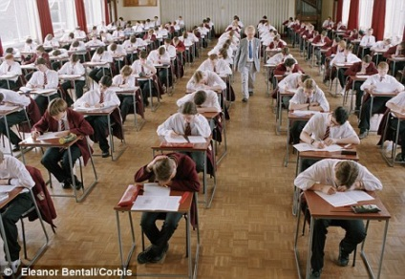
Independent writing:
Describe an experience that you have had that others might not have had.
Remember to interest your reader!

Slide 97
Finally:
Read through your description.
How successful is it in engaging a reader?
How could it be more successful?

Slide 98
To begin:
6.3.15
If a firm has two candidates, and one is male and one female, but both are equally qualified, who should get the job?

Slide 99
To begin:
6.3.15
If a firm has two candidates, and one is male and one female, but the man is more qualified, who should get the job?

Slide 100
To begin:
6.3.15
If a firm has two candidates, and one is male and one female, and the man is more qualified but the firm currently has no female employees, who should get the job?

Slide 101
Today we will explore how writing to argue can be made effective.

Slide 102

Notes:
What does this mean?

Slide 103
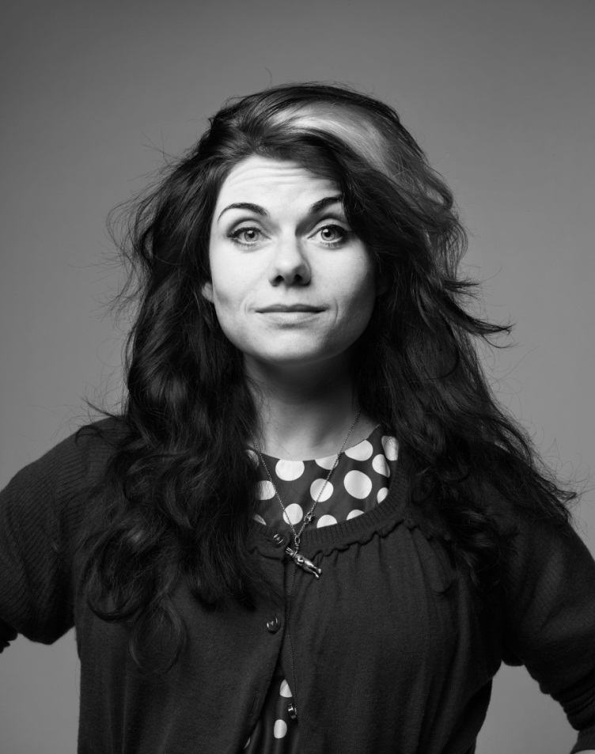
Caitlin Moran
Columnist for The Times
Previously wrote for The Guardian
Written many humorous books, including “How to be a Woman”

Slide 104
We will now read through Moran’s “Pelicans” article.

Slide 105
Answer the questions in pairs, finding at least one quote to support each of them.

Slide 106
Why does Moran think women aren’t speaking up?

Slide 107
What arguments is Moran making about women and their representation?

Slide 108
How does Moran make her arguments effective for a reader?

Slide 109
Independent writing:
What techniques does Moran use to make her argument effective for a reader?
Respond using PEE.

Slide 110
Finally:
We’ve looked at lots of feminist texts this week.
What ideas do you have about feminism?
Are you a feminist?

