Slide 1
How to Read
@jo_facer
readingallthebooks.wordpress.com

Slide 2
Why is reading so vital?
Weakest readers read the least
Strongest readers read the most
How do we close the gap?

Slide 3
Knowledge gap
Practice gap

Slide 4
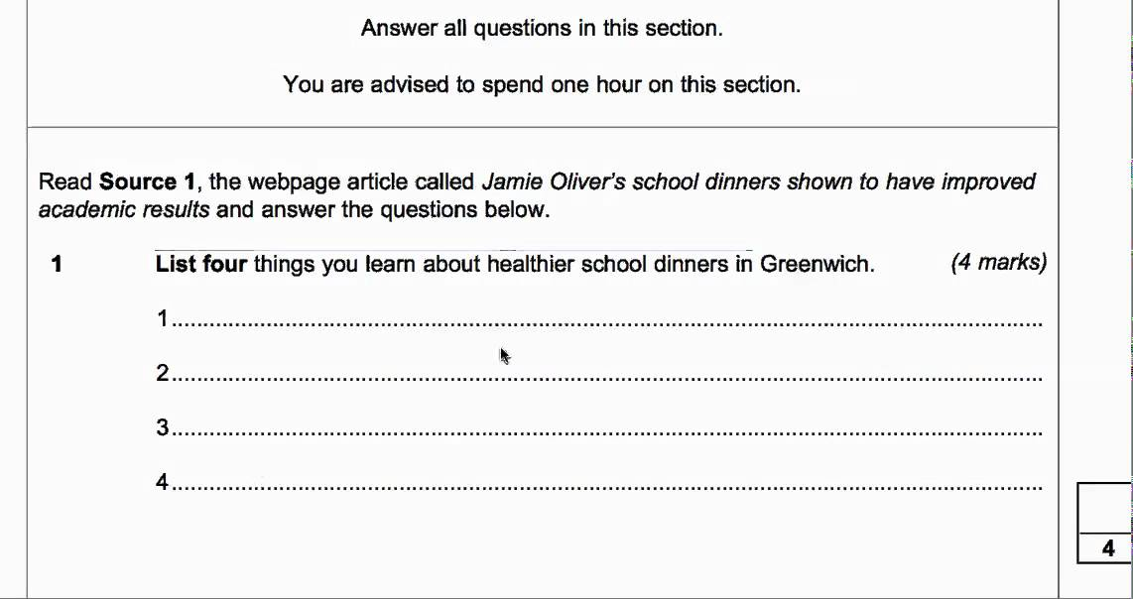
Notes:
New challenges: new GCSEs – more unseen, longer and more challenging texts; much more emphasis on students being able to do hard things. This is probably not a bad thing!

Slide 5
Reading
1. Decoding
2. Comprehension
3. Fluency
Notes:
What do we mean by reading?
Decoding; comprehension; fluency – 3 stages.

Slide 6
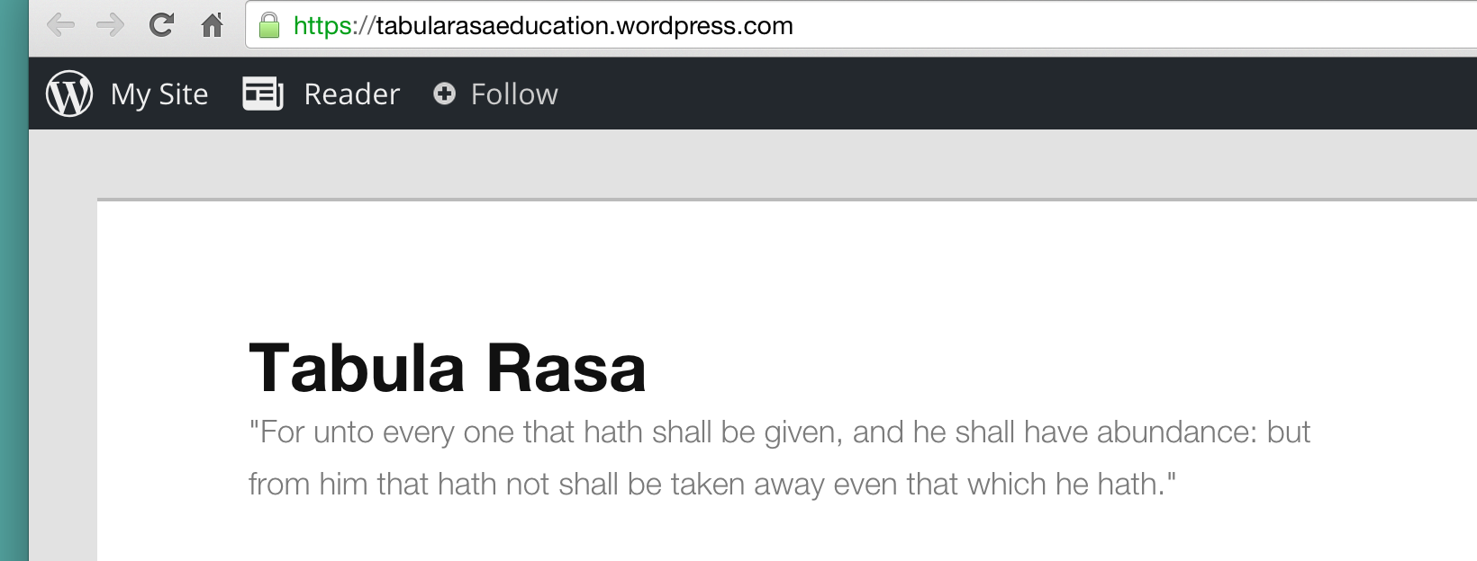
Decoding
Katie Ashford
tabularasaeducation.wordpress.com
Notes:
Best person on reading = Katie Ashford – Director of Inclusion at Michaela. Everything I know about mechanics of reading I learned from her.
tabularasaeducation.wordpress.com – How do I get them reading?
Explains many students → KS3 unable to read & 2ndary schools lack expertise to teach so slip through net
Ruth Miskin fresh start Y7; recommends 3 45 min sessions a week
If can decode but not comprehend: need lots of reading practice in class

Slide 7
1. Distinguish letters
2. Mapping between letters and sounds
3. Hearing the distinction between sounds
Notes:
Learning to read means mastering: 1. Being able to distinguish letters, 2. Learn mapping between letters and sounds, 3. Hearing distinction between sounds (so T = t-ee). Phonics also so important so students can decode unfamiliar words (give e.g. of Claire who would autocorrect words to words she knew as could not decode, was relying on whole word memory)

Slide 8
Comprehension
‘Around the 4th grade most kids decode pretty well, and suddenly the expectation for comprehension ratchets up. The result is that some kids who learned to decode just fine have trouble when they hit the higher comprehension demands in fourth grade.’
D.T. Willingham ‘Raising Kids Who Read’

Slide 9
Inference gap
Trisha spilled her coffee. Dan jumped from his chair to fetch a cloth.
Notes:
Inference gap – given and new information. Good readers can make the inference leap – ‘Trisha spilled her coffee. Dan jumped from his chair to fetch a cloth.’ – Need to know the link; ‘the given information is not really in the text. It’s in your head.’

Slide 10
Jones sacrificed and knocked in a run
Notes:
Reading relies on knowledge – if unfamiliar with subject content, reading becomes really hard! (Jones sacrificed and…) – ‘reading comprehension depends heavily on how much you happen to know about the topic of the text’

Slide 11

Jones sacrificed and knocked in a run
Notes:
Reading relies on knowledge – if unfamiliar with subject content, reading becomes really hard! (Jones sacrificed and…) – ‘reading comprehension depends heavily on how much you happen to know about the topic of the text’

Slide 12
‘But whosoever hath not, from him shall be taken away even that he hath.’
Notes:
Most people acquire this broad general knowledge by reading; Matthew effect though- Ian Lewis ‘knowledge loves knowledge’

Slide 13
‘Kids who don’t have very rich background knowledge – often those from impoverished homes – start to struggle with reading in third or fourth grade, even though they had been doing fine up to that point.’
D.T. Willingham
Notes:
Concern is = students are often taken out of subject to practice reading; but ironically this can hold students back as becoming really fluent reader depends on wide background knowledge so they can start to comprehend what they read

Slide 14

Notes:
Question: how do you know every child in your year 7/8/9/10/11 class can read fluently? (Do you know? Have you had children you can think of who couldn’t read? (Comprehend) What did you do about it?)
Clearly we need to ensure we have heard all students read.
Remember – programme about a school’s inclusive learning centre on BBC last year where a student in her exam broke down because she couldn’t read the paper.

Slide 15
Why should we ask students to read aloud in class?
Notes:
Why should we read aloud with students?
1. So we know they can read (Lemov talks about this as a ‘source of data.’)
2. So we know they can read with expression and fluency
3. So we know they are listening during the lesson
4. To enable us to check for understanding (harder when they are reading silently at different speeds)
5. Reading aloud with classes is one of the most enjoyable experiences there is – sharing of story

Slide 16
But how?
Notes:
For teachers in some schools, this is as easy as picking students at random to read a paragraph, which they will do with expression and ease. But this is not true for very many teachers.
What I used to do:
Read the whole of TKAM to my year 10 class – not a confident reader and so very hard going; students clapped at the end with relief
Guided reading – not sure everyone was reading, understanding etc – misconceptions becoming embedded

Slide 17

Notes:
Reading aloud
I wasn’t a confident reader in school; fear of reading aloud
Y10 intervention group – practiced reading aloud to get confidence up
Able to be more entertaining as a reader and do actions to go with words (e.g. creeping around the floor while reading ‘The Yellow Wallpaper’)
Y10 not strong readers and had avoided asking to read aloud for fear would make feel bad, but one lesson as I was reading a student started reading with me at the same time – thought she was being naughty but decided not to push it, and read slowly quieter and quieter and she kept going.
Magical moment transformed the class – many students started asking to read

Slide 18
‘…Others have opined that students should not be asked to read aloud in class because they might struggle, and that would shame them or cause them to hate reading. Essentially, the argument here is that if students are weak readers, we should not ask them to read, withholding from them the best tool for learning to read because it might make them feel anxious.’
Doug Lemov, TLAC 2.0
Notes:
How do you get students to read/deal with low confidence?

Slide 19
A good reading lesson:
https://tabularasaeducation.wordpress.com/2015/03/21/how-should-we-read-texts-in-lessons/
In any lesson, reading should primarily be for comprehension. Pupils need to understand what they are reading, and so the teacher should pause at appropriate moments and check for understanding.
Reading is an opportunity to improve pupils’ fluency and ability to read with expression. Teachers should therefore model good reading and ask pupils to read aloud.
Reading is an excellent opportunity to improve pupils’ vocabulary. Teachers should pause to explain the meaning of key words, and may want to give further examples of new words used in context.
Notes:
Best way to teach vocabulary; how many words per lesson?

Slide 20
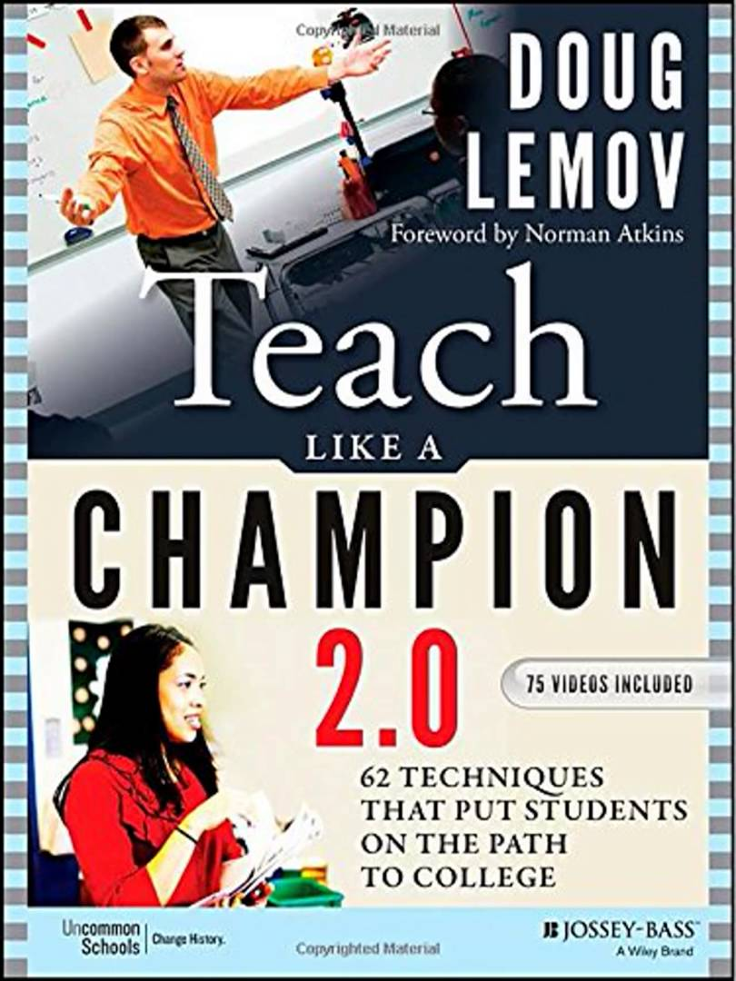
‘Control the Game’

Slide 21
1. Vague
2. Short
3. Unpredictable
4. Reduce transaction
5. Model
Notes:
1. Keep it vague – if you state how long they will be reading others can switch off. Instead ‘start reading for me, please, X,’ or ‘pick up from there, Y.’
2. Keep duration short – hard to maintain expressive reading for a whole page. Better to read 3-4 sentences really well. Knowing segments can be short and end at any time reinforces others will get a chance. You can extend the length as students become more confident.
3. Keep it unpredictable – don’t go around the class predictably so they know their turn is next and can tune out worrying about it, or switch off.
4. Reduce transaction costs – ‘Susan pick up’ is much quicker than ‘Thank you, Stephen. Nicely read. Susan, will you begin reading please?’ – so more time is spent reading (couple of seconds may seem trivial but if you transition 50 times in one class, four times a week, 39 weeks a year – you see)
5. Model the reading you hope to see in students – so they have something to aim for; also good for teacher to read especially important bits/tricky passages

Slide 22
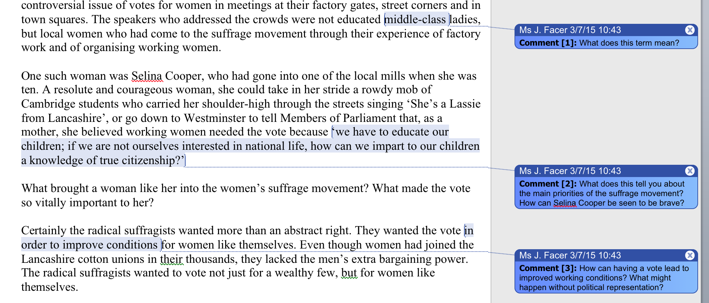
Notes:
What does it look like in practice?
Need students to understand what they are reading and we need to know they understand. Can do this by cold calling students as you read and asking questions; even better if these are pre-planned (show example below from Women SoW) – remember that writers often leave gaps and weaker readers can’t always access information, so bring that out through your questioning. Flag up unfamiliar key words at the start of a lesson and test them on those words, ideally revisiting them in later lessons [& e.g. scripted all questions for all iGlobal lessons]

Slide 23
Creating a culture of reading
Notes:
For our students to be able to read we need to create a culture of reading; probably not going to be able to read every single page in class time. Don’t want to flock to the shortest texts for GCSE at expense of longer ones.

Slide 24
‘If you want to raise a reader, your child must decode easily, comprehend what he reads, and be motivated to read.’
D.T. Willingham, Raising Kids Who Read

Slide 25
1. Create a community
2. Inform students
3. Time for reading
4. Programmes for reading
Notes:
Reading = highly emotional; need to be mindful of associating reading with positive always. But positive emotion not by rewards – Willingham cites experiment where pens were put in a classroom. Some students were offered ‘good player’ certificates if they worked with the markers, others weren’t. When the pens reappeared in the classroom, the ones offered the certificates showed no interest in using them – what’s the point if they’re not rewarded for it?]
1. Creating a community of readers
“If reading is to become a lifelong habit then people must see themselves as participants in a community that views reading as a significant and enjoyable activity.” (National Literacy Trust, 2006)
Ms/Mr is currently reading (at Globe all teachers have)
Within English: Stop lessons 5 mins before end and share book reading/enjoyed with students; students start to take this on depending on age and motivation
2. Informing students
Often students don’t know what to read – lots and lots of lists, posters, information, assemblies. Let them tell each other what they are reading. Let reluctant readers read junk – it is a gateway genre!
3. Time for reading
Reading homework; tutor time (very tricky – but MCS have a plan); reading before assembly
4. Programmes for reading
Carnegie book club; Sherlock book club; book challenge

Slide 26
Implications for lesson planning:
1. Content
2. Script questions
3. Control the game
4. Test comprehension
Notes:
Content up front – the most important thing!
Then script your questions
Then practice controlling the game in class
Then test students’ comprehension

Slide 27
Implications for school planning:
1. Reading at the heart of every lesson
2. All teachers on board
3. Make it visual
4. Make it the most attractive option
Notes:
About lesson time and ensuring literacy is at heart of every lesson (except maybe maths?)
Re: all teachers talking about reading
Lots and lots of information about books
Reading = emotional

Slide 28
How do we redesign lessons with literacy in mind?
How do we ensure reading is at the heart of our schools?
Notes:
Task: how will you redesign your lessons with literacy in mind?
How would you teach this text? (Handout)

Slide 29
What are the challenges in your classroom?

