Slide 1
Memory in English
@jo_facer
readingallthebooksuk.wordpress.com

Slide 2
Why is memory important in English?
What is memory, and how does it work?
How can we build memory in English in a classroom?
How can we build memory in English as a whole school?

Slide 3
Why is memory important in English?

Slide 4
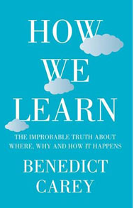
‘…networks of perceptions…’

Slide 5
Jones sacrificed and knocked in a run

Slide 6

Jones sacrificed and knocked in a run

Slide 7
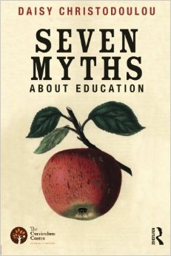
‘General knowledge is like oxygen. It is vitally important, but we only notice it when it is not there.’

Slide 8
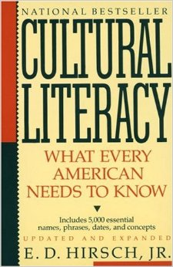
‘Less privileged children are denied consistent interchanges with literate persons and fail to receive this information in school.’

Slide 9
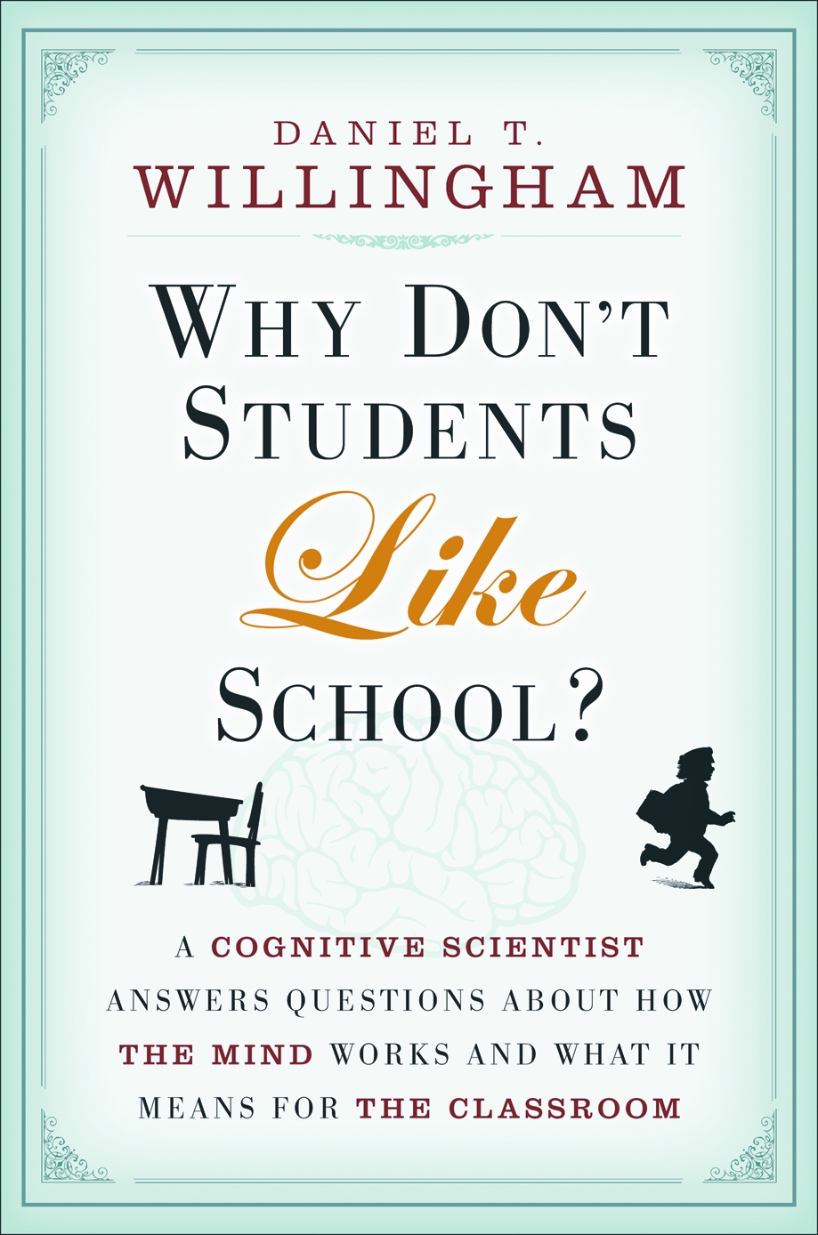
‘When it comes to knowledge, those who have more gain more.’

Slide 10
‘But whosoever hath not, from him shall be taken away even that he hath.’
Notes:
Most people acquire this broad general knowledge by reading; Matthew effect though- Ian Lewis ‘knowledge loves knowledge’

Slide 11
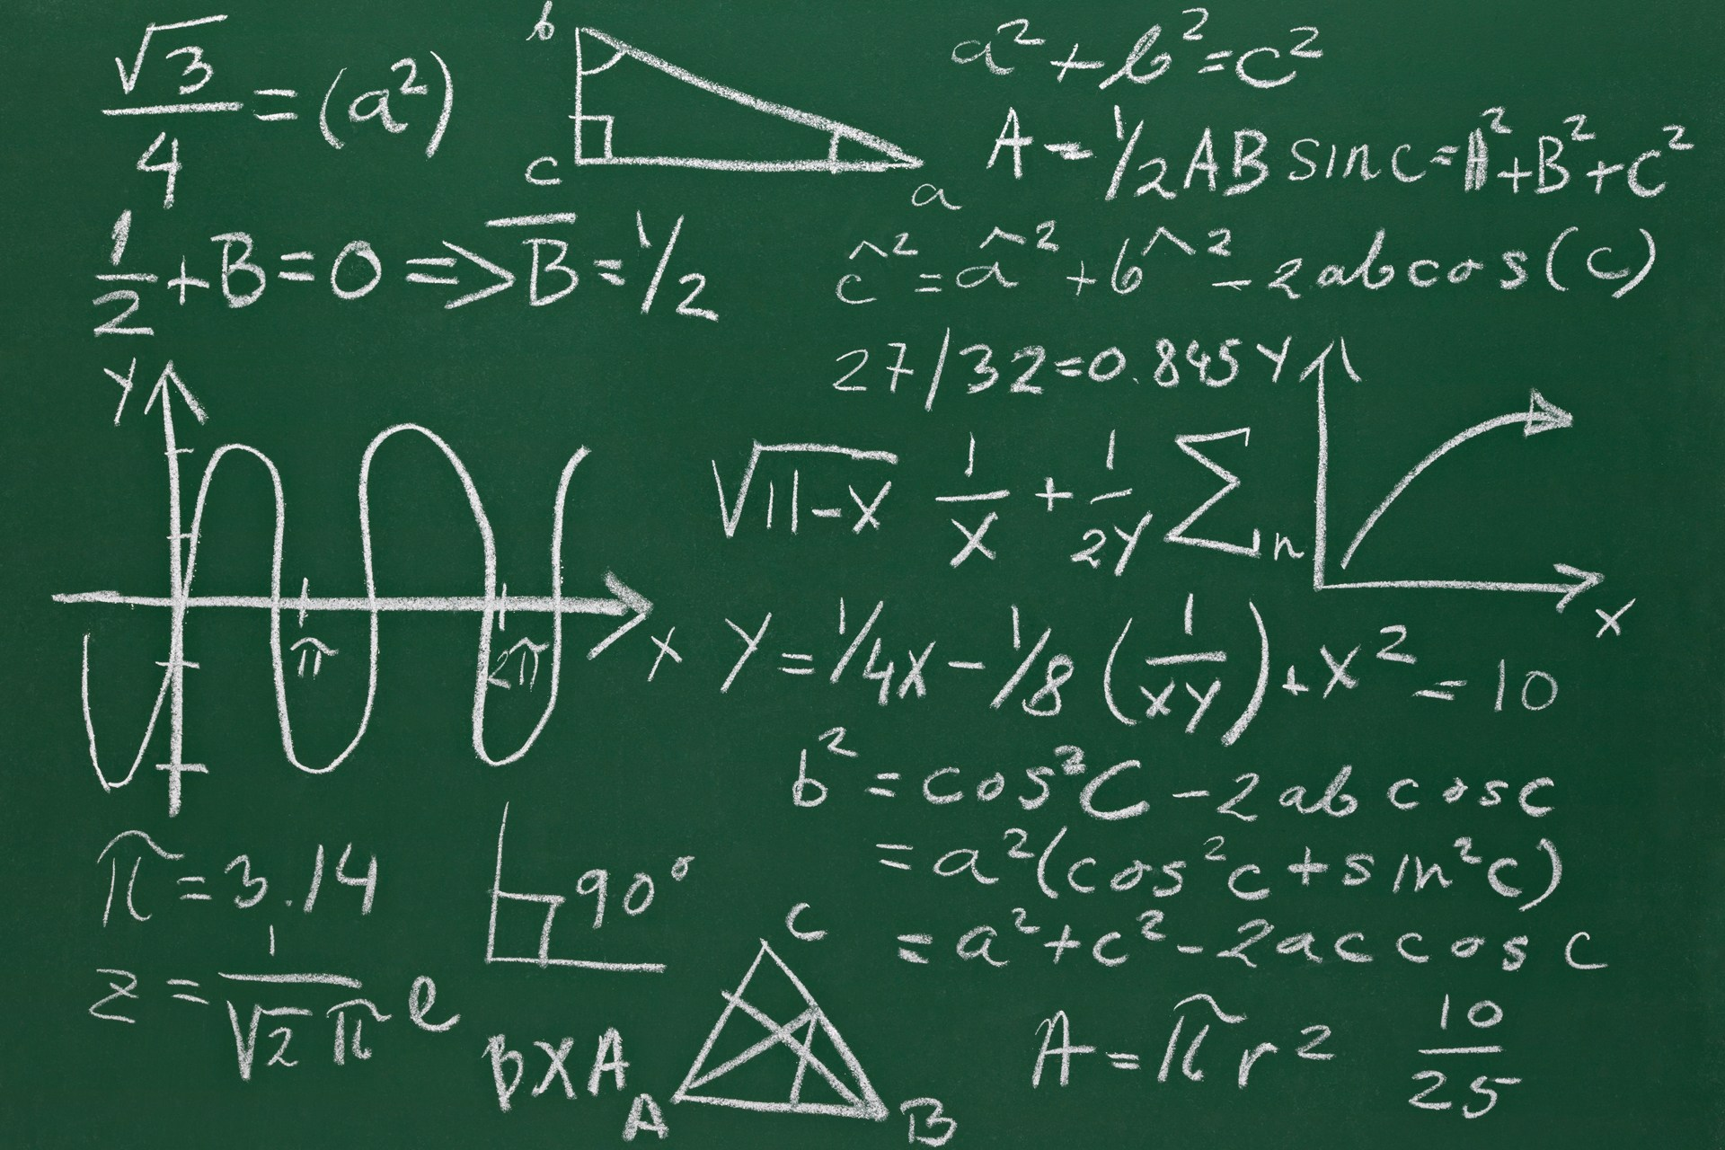
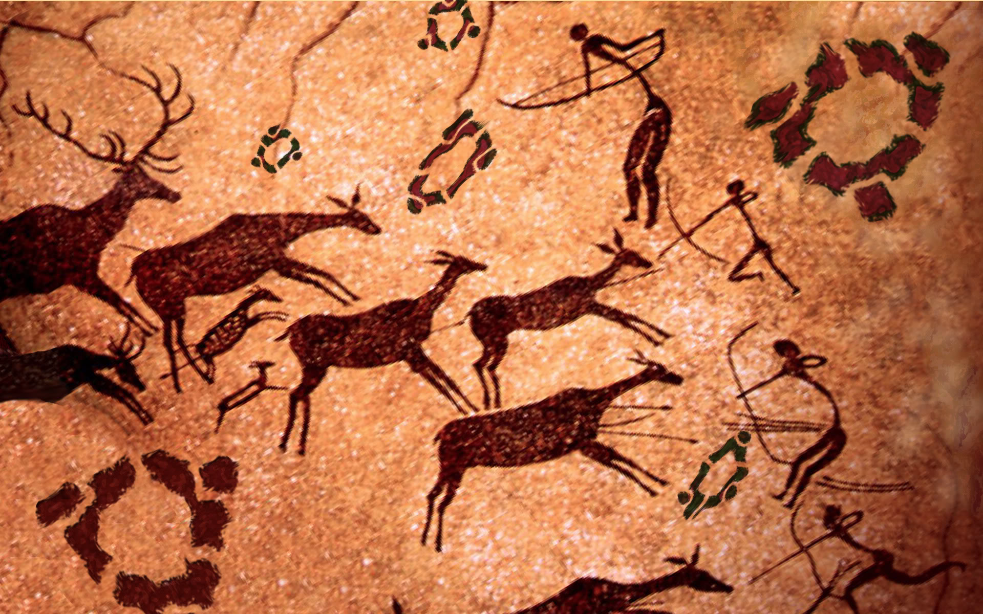
Analysis

Slide 12
‘We achieve skilled performance through committing knowledge to long-term memory and practising using it.’

Slide 13
othmarstrombone.wordpress.com
‘The Knowledge’
‘The Skills’

Slide 14
What is memory, and how does it work?

Slide 15
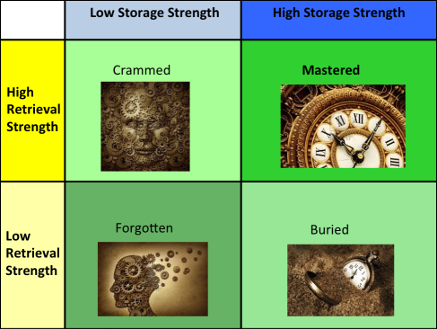
pragmaticreform.wordpress.com

Slide 16
‘Memory is the residue of thought.’

Slide 17
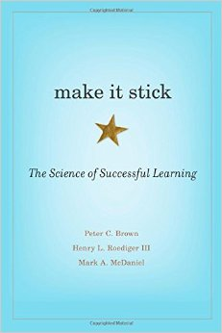
‘Learning is deeper and more durable when it’s effortful.’

Slide 18
‘desirable difficulties’

Slide 19
How can we build memory in English in a classroom?

Slide 20
‘new information combined with minimal guidance does not lead to effective learning. Instead, it leads to confusion, frustration and misconceptions.’

Slide 21
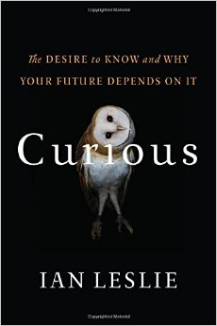
‘Why does it matter if a child knows the date of the Battle of Hastings?’

Slide 22
‘It matters because facts stored in long-term memory are not islands unto themselves; they join up with other facts to form associative networks of understanding.’

Slide 23
A. Mary Shelley’s Frankenstein: Context
1665 | John Milton writes ‘Paradise Lost’
1793 | The Enlightenment creates the French terror and guillotine
1797 | Coleridge writes The Rime of the Ancient Mariner
1797 | Mary Wollstonecraft dies after giving birth to her daughter Mary
1816 | Shelley’s wife Harriet commits suicide after Percy eloped with Mary
1816 | Byron writes his poem, ‘Prometheus’
1815 | Three of Mary’s four children die in childbirth
1816 | Mary writes a diary entry about her dream on the death of her child
1816 | Byron, Percy and Mary Shelley tell ghost stories in Geneva
1818 | Mary Shelley publishes her novel Frankenstein
B. Characters
1. Robert Walton |  | Explorer seeking the North Pole
2. Victor Frankenstein |  | Scientist who creates a living creature
3. The Creature |  | Ostracised as monstrous, he murders Victor’s family
4. Elizabeth Lavenza |  | marries Frankenstein, is killed on her wedding night
5. Justine Moritz |  | convicted of murder of Victor’s brother
6. Henry Clerval |  | Family friend killed by the creature
C. Themes
1. Hubris and Nemesis |  |  | recreating life has terrible consequences
2. Romantic and Gothic |  |  | terror and imagination, natural and unnatural
3. Prejudice and Revenge |  |  | alienation and murder
4. Innocence and Loss |  |  | Justine, William, Henry, Elizabeth and Alfonse die
5. Science and Creation |  |  | nurture and nature
6. Death and Birth |  |  | Victor’s mother’s death leads to a creature’s birth
7. Society and Isolation |  |  | Enlightenment reason and exclusion
D. Plot
1. Letters 1-4 | Captain Robert Walton sailing to the North Pole, writes letters to his sister telling of his dangerous mission and finding Frankenstein.
2. Chapters 1-3 | The Frankensteins adopt Elizabeth; Henry Clerval is a family friend; Victor studies at Ingolstadt.
3. Chapters 4-6 | Victor studies and animates matter; he brings a creature to life; Elizabeth entreats Victor to return.
4. Chapters 7-9 | Victor’s father writes that Victor’s brother William has been murdered; Justine is hanged for murder; Victor goes to the Alps.
5. Chapters 10-12 | Victor meets the creature in the Alps; the creature tells his story, and how he came to learn language.
6. Chapters 13-15 | The creature tells of learning reading, history and literature; he meets the old man in the cottage, but the others beat him away.
7. Chapters 16-18 | The creature tells of murdering Victor’s brother, and framing Justine; he demands Victor create him a female; Victor concedes.
8. Chapters 19-22 | Victor in Scotland creates another creature; in terror he destroys it; the creature threatens his wedding night; he finds Clerval dead.
9. Chapters 22-24 | Victor marries Elizabeth; the creature finds and kills her; Victor pursues the creature to the North Pole.
10. Letters 5-9 | Walton writes of Frankenstein’s death, his encounter with the creature, who tells of his immense suffering, then leaves to die.
E. Literary Devices
1. Perspective |  | shifting viewpoint
2. Allusions |  | references to other literature
3. Prolepsis |  | foreboding, foreshadowing, prefiguring
4. Epithets |  | characteristic words used for a character
5. Symbolism |  | light, fire, ice
6. Pathetic Fallacy |  | the weather represents the characters’ mindsets
7. Gothicism |  | horror, terror, obsession and evil
8. Romanticism |  | imagination, nature and the mind
9. Epistolary Novel |  | letters posted between characters
10. Epiplexis |  | multiple rhetorical questions

Slide 24
Why use knowledge maps?
1. Decisions
2. Clarity
3. Revision

Slide 25
‘One of the best habits a learner can instil in herself is regular self-quizzing.’

Slide 26
Quizzing
1. Purposeful
2. Targeted
3. Instantly corrected

Slide 27
Why use multiple choice questions?
1. Workload
2. Diagnosis
3. Breadth

Slide 28
How to design multiple choice questions:
1. Five options
2. Plausible distractors
3. Unambiguously wrong distractors
4. Misconceptions as distractors
5. Multiple correct options

Slide 29
When did Mary Shelley publish her novel, ‘Frankenstein’?
A) 1665
B) 1793
C) 1797
D) 1815
E) 1818
Notes:
E

Slide 30
What happened in 1797?
A) John Milton wrote ‘Paradise Lost.’
B) The Enlightenment created the French terror and the guillotine.
C) Coleridge wrote ‘The Rime of the Ancient Mariner.’
D) Three of Mary’s four children died in childbirth.
E) Mary Shelley published her novel ‘Frankenstein.’
Notes:
C

Slide 31
A. Mary Shelley’s Frankenstein: Context
1665 | John Milton writes ‘Paradise Lost’
1793 | The Enlightenment creates the French terror and guillotine
1797 | Coleridge writes The Rime of the Ancient Mariner
1797 | Mary Wollstonecraft dies after giving birth to her daughter Mary
1816 | Shelley’s wife Harriet commits suicide after Percy eloped with Mary
1816 | Byron writes his poem, ‘Prometheus’
1815 | Three of Mary’s four children die in childbirth
1816 | Mary writes a diary entry about her dream on the death of her child
1816 | Byron, Percy and Mary Shelley tell ghost stories in Geneva
1818 | Mary Shelley publishes her novel Frankenstein
B. Characters
1. Robert Walton |  | Explorer seeking the North Pole
2. Victor Frankenstein |  | Scientist who creates a living creature
3. The Creature |  | Ostracised as monstrous, he murders Victor’s family
4. Elizabeth Lavenza |  | marries Frankenstein, is killed on her wedding night
5. Justine Moritz |  | convicted of murder of Victor’s brother
6. Henry Clerval |  | Family friend killed by the creature
C. Themes
1. Hubris and Nemesis |  |  | recreating life has terrible consequences
2. Romantic and Gothic |  |  | terror and imagination, natural and unnatural
3. Prejudice and Revenge |  |  | alienation and murder
4. Innocence and Loss |  |  | Justine, William, Henry, Elizabeth and Alfonse die
5. Science and Creation |  |  | nurture and nature
6. Death and Birth |  |  | Victor’s mother’s death leads to a creature’s birth
7. Society and Isolation |  |  | Enlightenment reason and exclusion
D. Plot
1. Letters 1-4 | Captain Robert Walton sailing to the North Pole, writes letters to his sister telling of his dangerous mission and finding Frankenstein.
2. Chapters 1-3 | The Frankensteins adopt Elizabeth; Henry Clerval is a family friend; Victor studies at Ingolstadt.
3. Chapters 4-6 | Victor studies and animates matter; he brings a creature to life; Elizabeth entreats Victor to return.
4. Chapters 7-9 | Victor’s father writes that Victor’s brother William has been murdered; Justine is hanged for murder; Victor goes to the Alps.
5. Chapters 10-12 | Victor meets the creature in the Alps; the creature tells his story, and how he came to learn language.
6. Chapters 13-15 | The creature tells of learning reading, history and literature; he meets the old man in the cottage, but the others beat him away.
7. Chapters 16-18 | The creature tells of murdering Victor’s brother, and framing Justine; he demands Victor create him a female; Victor concedes.
8. Chapters 19-22 | Victor in Scotland creates another creature; in terror he destroys it; the creature threatens his wedding night; he finds Clerval dead.
9. Chapters 22-24 | Victor marries Elizabeth; the creature finds and kills her; Victor pursues the creature to the North Pole.
10. Letters 5-9 | Walton writes of Frankenstein’s death, his encounter with the creature, who tells of his immense suffering, then leaves to die.
E. Literary Devices
1. Perspective |  | shifting viewpoint
2. Allusions |  | references to other literature
3. Prolepsis |  | foreboding, foreshadowing, prefiguring
4. Epithets |  | characteristic words used for a character
5. Symbolism |  | light, fire, ice
6. Pathetic Fallacy |  | the weather represents the characters’ mindsets
7. Gothicism |  | horror, terror, obsession and evil
8. Romanticism |  | imagination, nature and the mind
9. Epistolary Novel |  | letters posted between characters
10. Epiplexis |  | multiple rhetorical questions

Slide 32
‘My Fate is nearly fulfilled.’ What theme does Shelley allude to here, and what language technique does she use?
A) Mary Shelley alludes to the theme of fate, and uses epiplexis.
B) Mary Shelley alludes to the theme of transience, and uses Gothicism.
C) Mary Shelley alludes to the theme of despair, and uses allusion.
D) Mary Shelley alludes to the theme of destiny, and uses alliteration.
E) Mary Shelley alludes to the theme of the inescapable, epithets.
Notes:
D

Slide 33
‘The world was to me a secret which I desired to divine.’ What does this quotation reveal about Frankenstein’s character?
A) This quotation reveals that Frankenstein is curious and obsessed with discovery even beyond human limits.
B) This quotation reveals that Frankenstein is interested in science above all else.
C) This quotation reveals that Frankenstein wishes to be as powerful as the divine God.
D) This quotation reveals that Frankenstein seeks revenge on his university professors.
E) This quotation reveals that Frankenstein is isolated from human society.
Notes:
A

Slide 34
How can we build memory in English in a classroom?

Slide 35
Hidden bodies of knowledge

Slide 36
Sequence

Slide 37
A. Mary Shelley’s Frankenstein: Context
1665 | John Milton writes ‘Paradise Lost’
1793 | The Enlightenment creates the French terror and guillotine
1797 | Coleridge writes The Rime of the Ancient Mariner
1797 | Mary Wollstonecraft dies after giving birth to her daughter Mary
1816 | Shelley’s wife Harriet commits suicide after Percy eloped with Mary
1816 | Byron writes his poem, ‘Prometheus’
1815 | Three of Mary’s four children die in childbirth
1816 | Mary writes a diary entry about her dream on the death of her child
1816 | Byron, Percy and Mary Shelley tell ghost stories in Geneva
1818 | Mary Shelley publishes her novel Frankenstein
B. Characters
1. Robert Walton |  | Explorer seeking the North Pole
2. Victor Frankenstein |  | Scientist who creates a living creature
3. The Creature |  | Ostracised as monstrous, he murders Victor’s family
4. Elizabeth Lavenza |  | marries Frankenstein, is killed on her wedding night
5. Justine Moritz |  | convicted of murder of Victor’s brother
6. Henry Clerval |  | Family friend killed by the creature
C. Themes
1. Hubris and Nemesis |  |  | recreating life has terrible consequences
2. Romantic and Gothic |  |  | terror and imagination, natural and unnatural
3. Prejudice and Revenge |  |  | alienation and murder
4. Innocence and Loss |  |  | Justine, William, Henry, Elizabeth and Alfonse die
5. Science and Creation |  |  | nurture and nature
6. Death and Birth |  |  | Victor’s mother’s death leads to a creature’s birth
7. Society and Isolation |  |  | Enlightenment reason and exclusion
D. Plot
1. Letters 1-4 | Captain Robert Walton sailing to the North Pole, writes letters to his sister telling of his dangerous mission and finding Frankenstein.
2. Chapters 1-3 | The Frankensteins adopt Elizabeth; Henry Clerval is a family friend; Victor studies at Ingolstadt.
3. Chapters 4-6 | Victor studies and animates matter; he brings a creature to life; Elizabeth entreats Victor to return.
4. Chapters 7-9 | Victor’s father writes that Victor’s brother William has been murdered; Justine is hanged for murder; Victor goes to the Alps.
5. Chapters 10-12 | Victor meets the creature in the Alps; the creature tells his story, and how he came to learn language.
6. Chapters 13-15 | The creature tells of learning reading, history and literature; he meets the old man in the cottage, but the others beat him away.
7. Chapters 16-18 | The creature tells of murdering Victor’s brother, and framing Justine; he demands Victor create him a female; Victor concedes.
8. Chapters 19-22 | Victor in Scotland creates another creature; in terror he destroys it; the creature threatens his wedding night; he finds Clerval dead.
9. Chapters 22-24 | Victor marries Elizabeth; the creature finds and kills her; Victor pursues the creature to the North Pole.
10. Letters 5-9 | Walton writes of Frankenstein’s death, his encounter with the creature, who tells of his immense suffering, then leaves to die.
E. Literary Devices
1. Perspective |  | shifting viewpoint
2. Allusions |  | references to other literature
3. Prolepsis |  | foreboding, foreshadowing, prefiguring
4. Epithets |  | characteristic words used for a character
5. Symbolism |  | light, fire, ice
6. Pathetic Fallacy |  | the weather represents the characters’ mindsets
7. Gothicism |  | horror, terror, obsession and evil
8. Romanticism |  | imagination, nature and the mind
9. Epistolary Novel |  | letters posted between characters
10. Epiplexis |  | multiple rhetorical questions

Slide 38
‘People can keep only so much information in mind at once.’

Slide 39
‘Familiarity illusion’
‘Varied practice’
‘Interleaving’

Slide 40
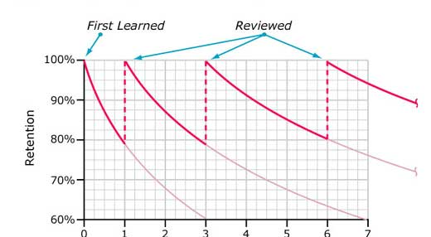

Slide 41

@LizzieStrang
Do all teachers have a firm understanding on key concepts/knowledge to be mastered in the SOW?
Could you make more use of systematic low stakes quizzes across the unit?
Do you revisit this unit at different points in the year?
Could you interleave this unit with any other topics taught?

Slide 42
Why is memory important in English?
What is memory, and how does it work?
How can we build memory in English in a classroom?
How can we build memory in English as a whole school?

Slide 43
1. What is knowledge comparable to and why?
a) We can compare knowledge to facts, because it means knowing only the facts and not their meaning.
b) We can compare knowledge to riding a bike, because you never forget it.
c) We can compare knowledge to oxygen, because it is vital but we only notice it when it is not there.
d) We can compare knowledge to a kite, because knowledge alone allows you to soar.
e) We can compare knowledge to a fingerprint, because each piece of knowledge is unique.

Slide 44
2. How many items can we hold in our working memory?
a) We can hold 1-2 items in our working memory.
b) We can hold 3-4 items in our working memory.
c) We can hold 5-6 items in our working memory.
d) We can hold 7-8 items in our working memory.
e) We can hold limitless items in our working memory.

Slide 45
3. What is the greatest benefit of teaching students isolated facts?
a) Teaching students isolated facts ensures students only have to learn a small number of ideas.
b) Teaching students isolated facts means students will focus on only those facts and will not be distracted by any other concepts or ideas.
c) Teaching students isolated facts means that they will be better prepared for the C21 society.
d) Teaching students isolated facts enables them to link knowledge together in a network of understanding.
e) Teaching students isolated facts means teachers don’t have to teach anything more complicated.

Slide 46
4. What is the most effective way to carry out retrieval practice?
a) It is most effective to space retrieval practice, to not allow time for students to forget between tests.
b) It is most effective to space retrieval practice, to allow time for students to begin to forget between tests.
c) It is most effective to carry out retrieval practice infrequently, as students don’t need to revisit key ideas as often as we think.
d) It is most effective to carry out retrieval practice immediately after teaching students knowledge.
e) It is most effective to drill retrieval practice, to ensure students are constantly being tested.

Slide 47
5. What is the best idea to use to organize your curriculum?
a) Cultural capital
b) Interleaving
c) Memory
d) Cross-curricular links
e) Something else

